Slide 1
Tableau visualization
Jerin Joseph

Slide 2
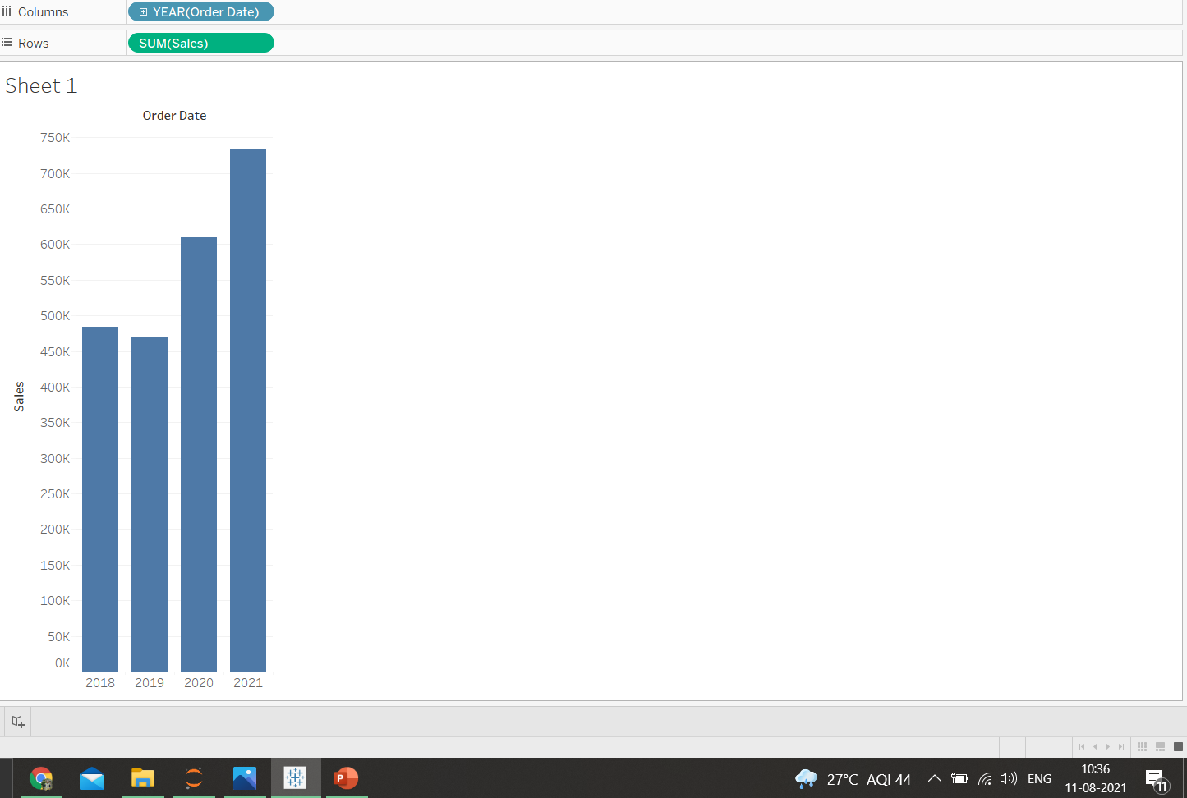
1.Find the sales for every year and find the highest sales and show the view in bar graph

Slide 3
The highest sales Is in 2021 which is 733215

Slide 4
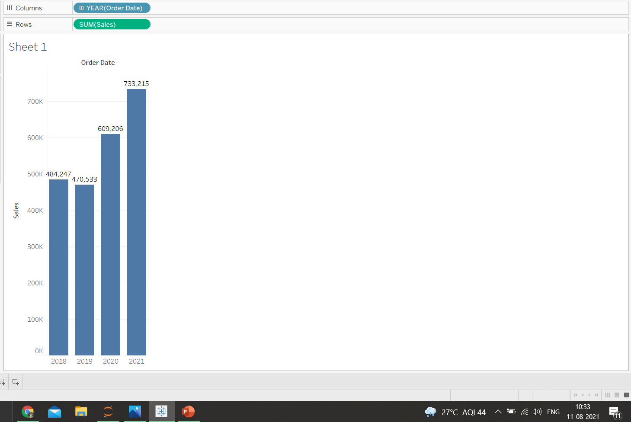
2.Add label to your view

Slide 5
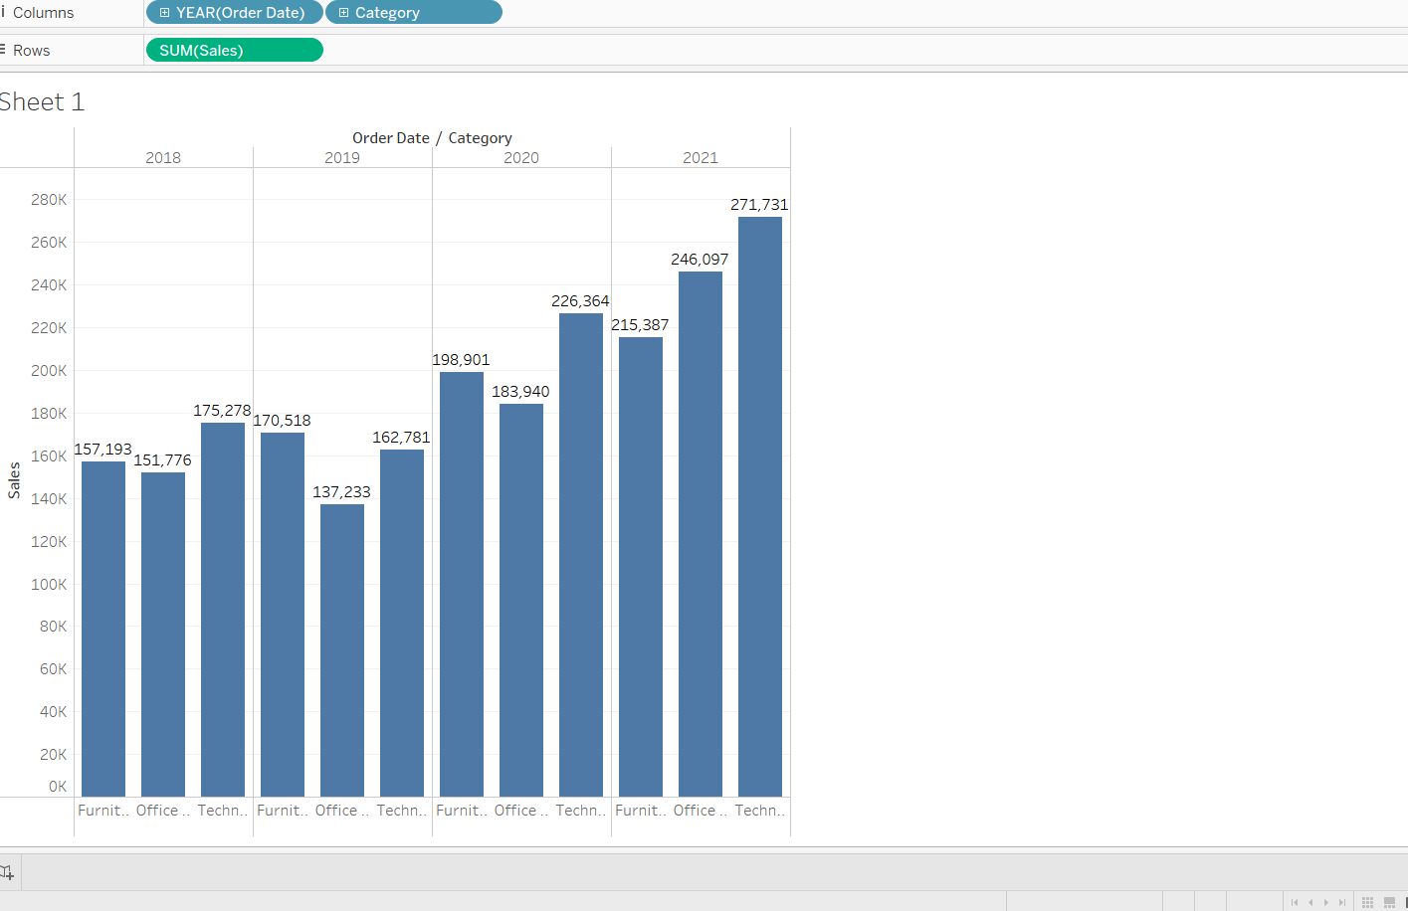
3.Find the category wise sales for every year

Slide 6
4.Which category has the highest sales in the year 2020 & 2021
From the previous image we can see that for the year 2020 and 2021 technology has the highest sales which is 226364 & 271731 respectively

Slide 7
5.Based on the analysis of the year 2020 and 2021,give some suggestions to improve sales in the year 2022
As in the year 2020 and 2021,technology has the highest sales so the main focus should be provided to technology sector for increased profits
As technology has been on n increase for past two years,proving that there is a probability for an increase in technology so we can focus part of the marketing and advertising to the furniture and office category
As furniture and office have lesser sales than technology we should find the inefficient departments in each category and either re-hire fresh and talented employees or provide a bonus for the employees to increase their efficiency
We can also implement the successful business model of Technology department and adapt it to the furniture and office department to more streamlined method to increases the sales which in turn will increase the profits

Slide 8
6.Display subcategory and find some insights from the view about max and min sales under every category
In the year 2020,category of furniture we see that chairs have the highest number of sales of 83919 and furnishing of 27874 which is the lowest
In the year 2020,category of office supplies we see that storage have the highest number of sales of 45408 and fasteners of 960 which is the lowest
In the year 2020,category of technology we see that phones have the highest number of sales of 78962 and accessories of 41986 which is the lowest
In the year 2021,category of furniture we see that chairs still has the highest number of sales of 83919 meaning good growth in this sub-category and furnishing of 28915 which is the lowest but a slight increase in from last year
In the year 2021,category of office supplies we see that binders have the highest number of sales of 72788 which beats storage by more than 50% shows great growth and fasteners of 858 which is the lowest,it has decreased from last year,a full revaluation of the entire department should be done to find the inefficiencies and improve them
In the year 2021,category of technology we see that phones have the highest number of sales of 105341 which has the increased by 30% which shows there is a high demand for mobiles which would further increase in the following years and machines of 41986 which is the lowest,an analysis should be done on department and to identify the NPA and it should be decided whether to improve them to remove from the department

Slide 9
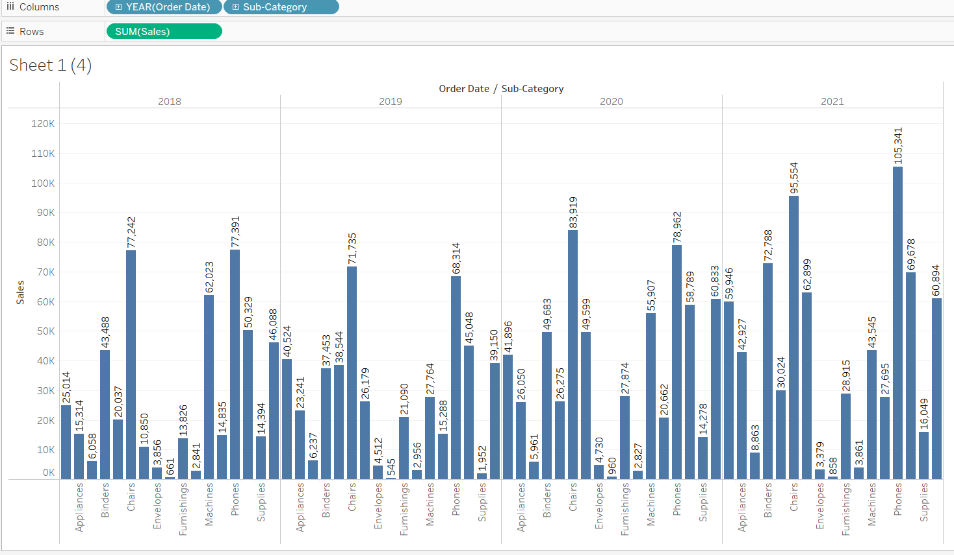

Slide 10
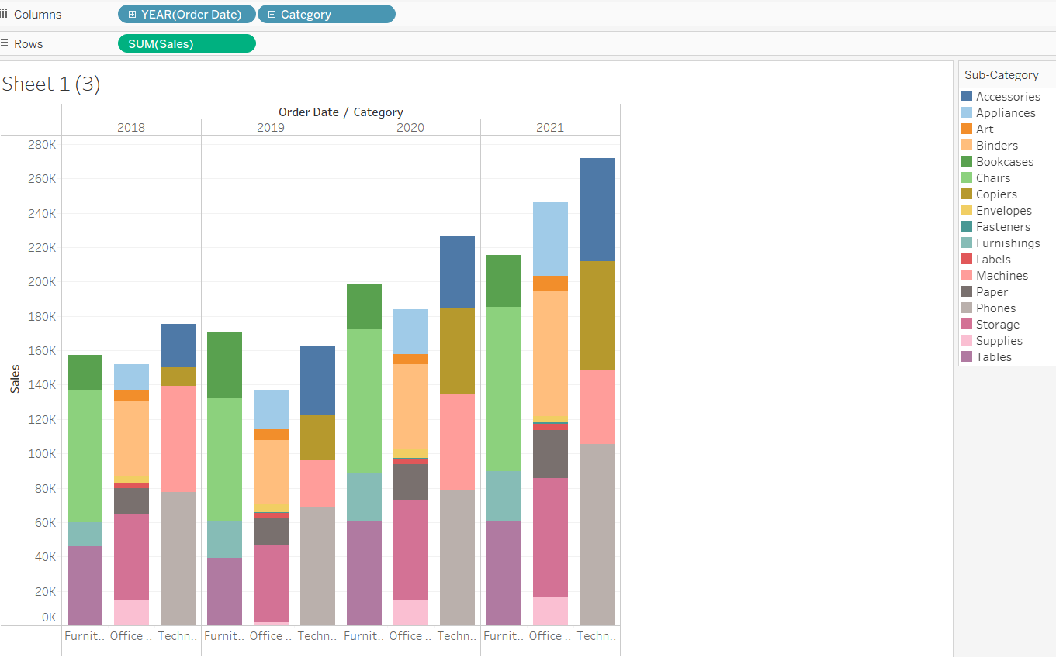
7.In your bar graph,present sub-category under each bar of category using color card

Slide 11
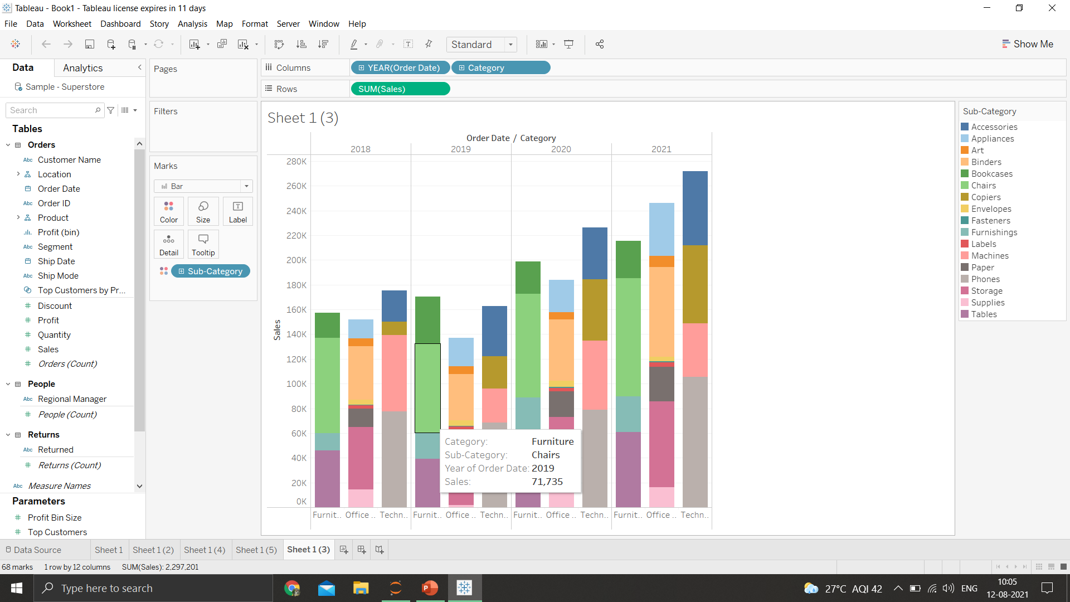
8.Check the tooltip

